Slide 1
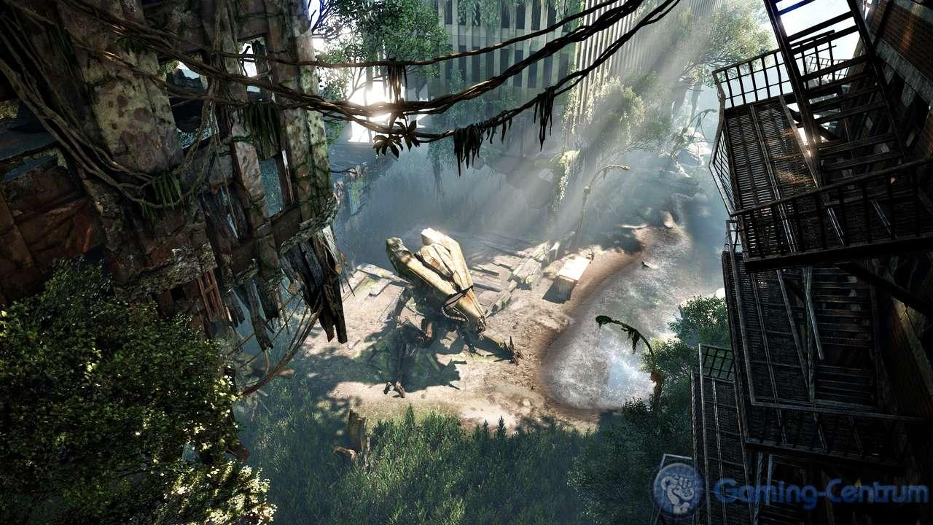
SHADOWS
For real-time rendering
Sean Lilley
Crysis 3 screenshot - http://www.gamingcentrum.com/wpcontent/uploads/2012/04/crysis42412-2.jpg

Slide 2
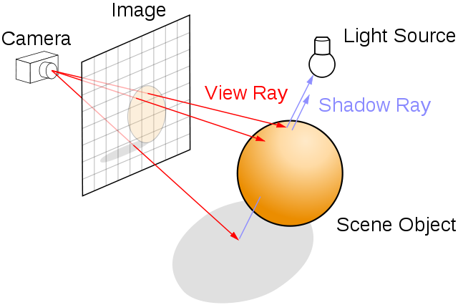
Hard shadows
Basic ray traced shadows:
Shoot ray from eye
Ray hits a surface
Send shadow ray out to check if the light reaches this point
If the shadow ray is obstructed, then the point is in shadow
http://upload.wikimedia.org/wikipedia/commons/8/83/Ray_trace_diagram.svg

Slide 3
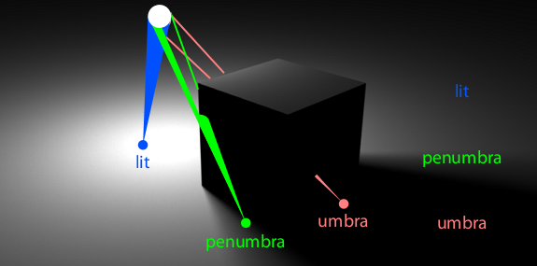
Soft shadows
More realistic than hard shadows
Light source treated as a physical object
Shadow rays are now more like cones
Penumbra: partially shadowed
Umbra: completely shadowed
http://www.cse.chalmers.se/~uffe/SIGGRAPH2012CourseNotes.pdf

Slide 4
Common Shadow Techniques
Shadow Volumes
Shadows are represented as polygonal volumes in space
Pros: accurate hard shadows
Cons: slow, rasterization heavy
Shadow Maps
Shadows are determined through depth buffer comparison tests
Pros: fast, support for soft shadows
Cons: high memory usage, aliasing
Notes:
2 main techniques for real time rendering.
Shadow volumes represented by actual geometry
Shadow maps don’t work in world space, but instead in image space, they use textures

Slide 5
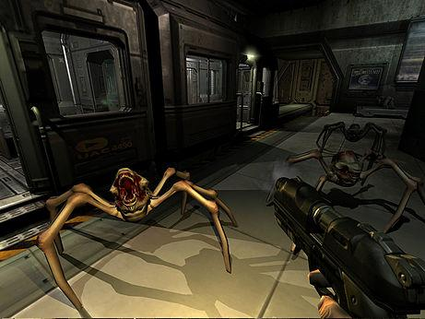
Shadow Volumes
Invented by Frank Crow in 1977
Popularized by Doom 3 in 2005
Doom 3 screenshot - http://en.wikipedia.org/wiki/File:Doom3shadows.jpg
Notes:
Now they aren’t used as much

Slide 6
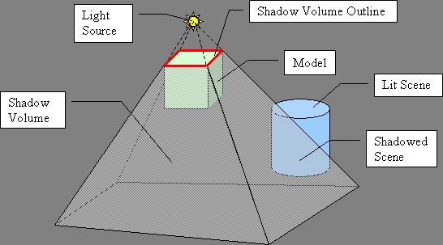
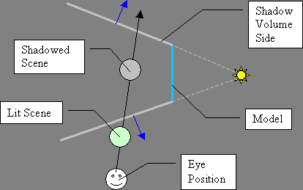
Shadow Volumes: Basic Approach
For each triangle in the scene, project its edges to infinity along the direction of the light.
This truncated pyramid is the shadow volume.
Any part of the scene that lies inside the shadow volume is shadowed.
3D view
2D view
http://www.sonic.net/~surdules/articles/cg_shadowvolumes/index.html

Slide 7
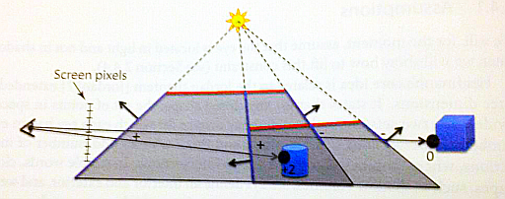
Shadow Volumes: Implementation
Depth pre-pass: render the scene into the depth buffer.
Render all shadow volumes
If the shadow volume fragment passes the depth test:
If the triangle is front-facing, increment the stencil buffer.
If the triangle is back-facing, decrement the stencil buffer.
If the value of the stencil buffer at a particular pixel is 0, then that pixel is not in shadow.
Now render the scene again, enabling the color buffer.
Use the stencil buffer as a mask. If the stencil buffer is greater than 0 for a particular fragment, discard the fragment
Else, compute diffuse and specular lighting like usual
Image: Real-Time Shadows by Eisemann et al.
Notes:
Depth prepass, don’t render any shadow volumes that you don’t need to

Slide 8
Shadow Volumes: Improvements
What if camera originates in a shadow volume? Won’t the stencil values be wrong?
Use z-fail (Carmack’s Reverse): If a shadow volume fails the depth test, increment stencil value if back-facing and decrement stencil value if front-facing.
Use the geometry shader to create shadow volumes easily on the GPU.
Emit triangle primitives for the shadow volume front cap, sides, and back cap.
Create shadow volumes from simplified meshes
Use occlusion culling to reduce the number of shadow volumes that need to be created.
http://http.developer.nvidia.com/GPUGems3/gpugems3_ch11.html
Notes:
Go back to previous slide to illustrate first bullet point
Z-fail: start shooting the ray from a point infinitely far away in the opposite direction. So the ray goes from infinity towards the camera along the view dir, rather than the camera to infinity along the view dir.
Show demonstration or reverse technique on previous slide.

Slide 9
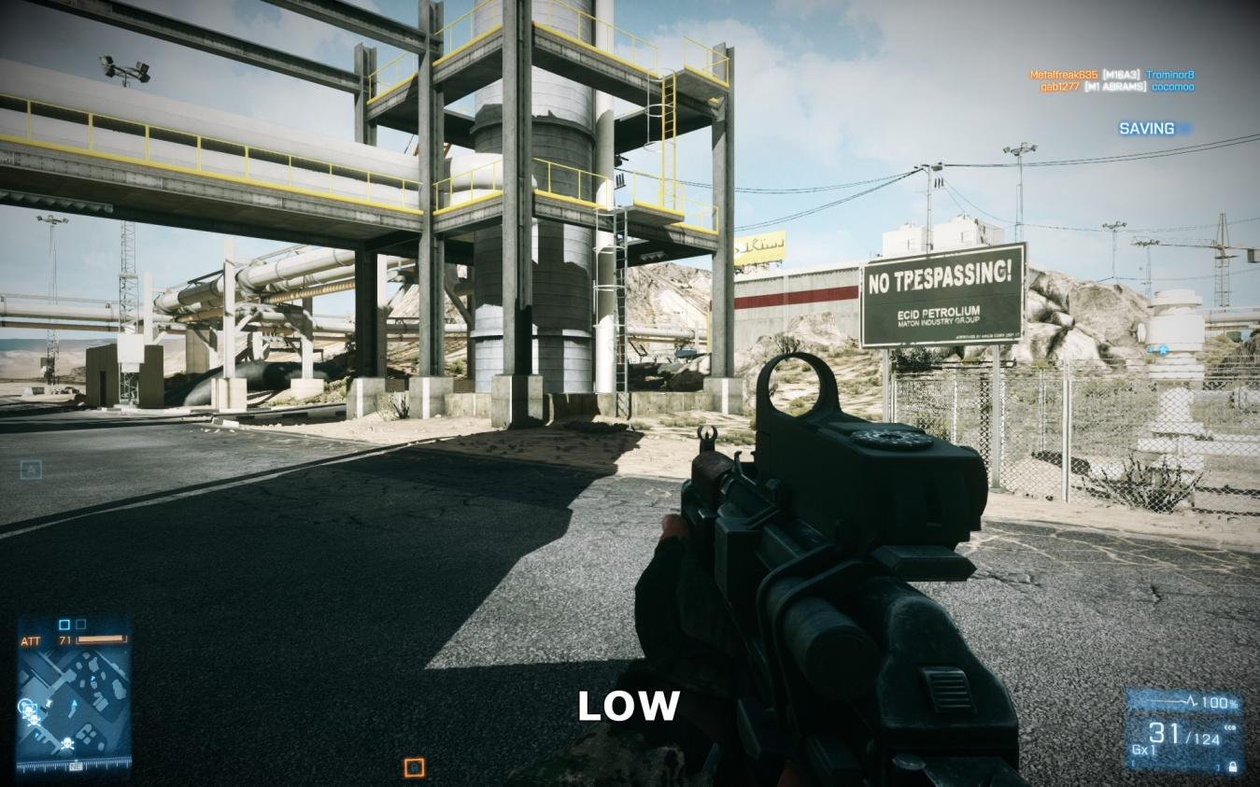
Shadow Maps
Invented by Lance Williams in 1978
Very popular. The dominant technique in today’s video games.
Battlefield 3 screenshot: http://www.geforce.com/Active/en_US/shared/images/guides/bf3-tweak/41_Shadows_Low.jpg

Slide 10
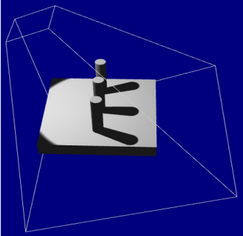

Basic Approach
Render the scene from the light’s point of view.
Treat the light like a camera.
Render to a depth texture to create the shadow map.
Render the scene from the camera’s point of view.
Transform each vertex from world space to light space in vertex shader.
Send light space position to fragment shader.
Compare the depth of the fragment to the depth stored in the shadow map. If the depth is greater, it is shadowed.
Light frustum
Shadow Map
http://developer.amd.com/media/gpu_assets/Isidoro-ShadowMapping.pdf
Notes:
Transforming to light space is sending a special matrix to the vertex shader, replacing view-projection

Slide 11
Light Types
Directional light (sun) – use orthographic projection
Spot light – use perspective projection
Point light – like spot light, but requires an omnidirectional shadow map.
Create six light frustums and render to a cube map inside the geometry shader.
Shadow mapping is expensive; usually only one light source casts shadows in a standard video game.
Notes:
Expensive because you have to render the scene from the light’s point of view and then from the camera’s point of view

Slide 12
Basic Shadow Mapping Problems
Projective Aliasing
Perspective Aliasing
Texture Resolution Limits

Slide 13
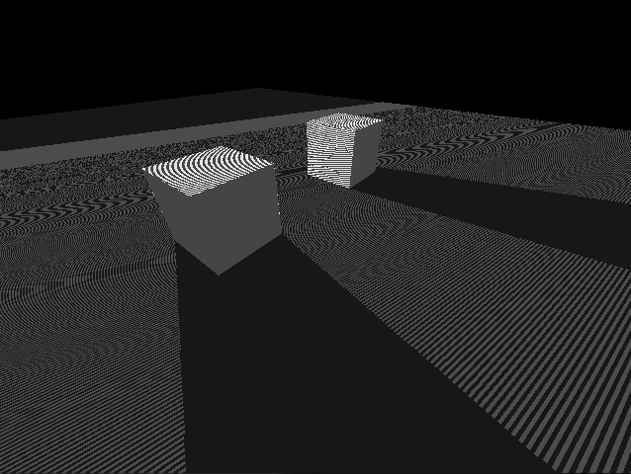
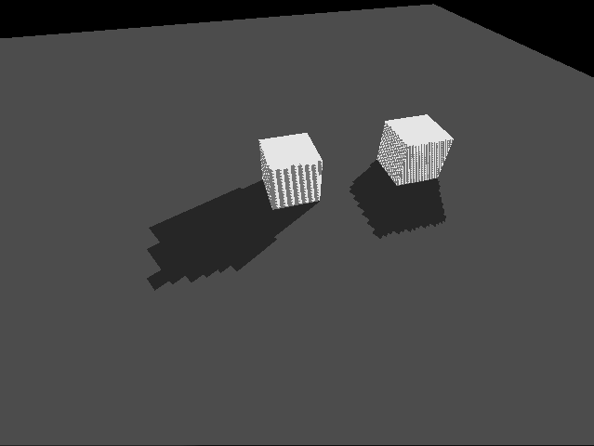
Projective Aliasing
Occurs when the slope of the geometry is parallel to the light direction
Best case: overhead light, flat floor
Worst case: overhead light, straight walls
Depth buffer precision, shadow map resolution, and float comparisons cause problems even for best case.
Called z-fighting
http://fabiensanglard.net/shadowmapping/index.php

Slide 14
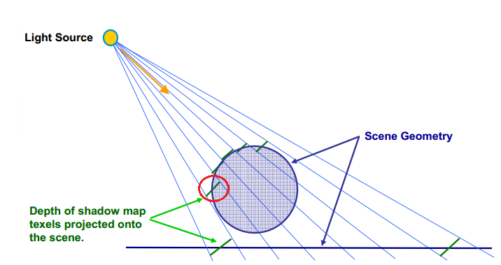
Projective Aliasing
Seriously affects the side of the circle
Modified from: http://developer.amd.com/media/gpu_assets/Isidoro-ShadowMapping.pdf

Slide 15
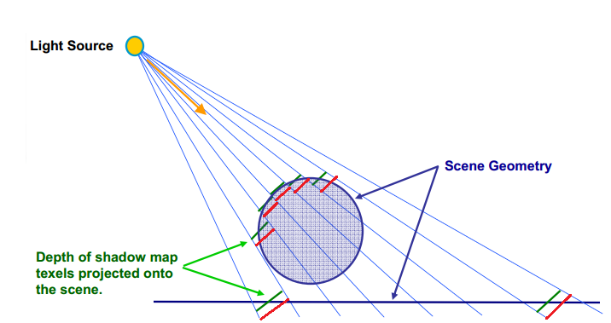
Depth Bias
Apply a constant depth bias
During light pass, push depths slightly deeper
Now depth comparison test will succeed in best case
Still problematic in worst case
Modified from: http://developer.amd.com/media/gpu_assets/Isidoro-ShadowMapping.pdf

Slide 16
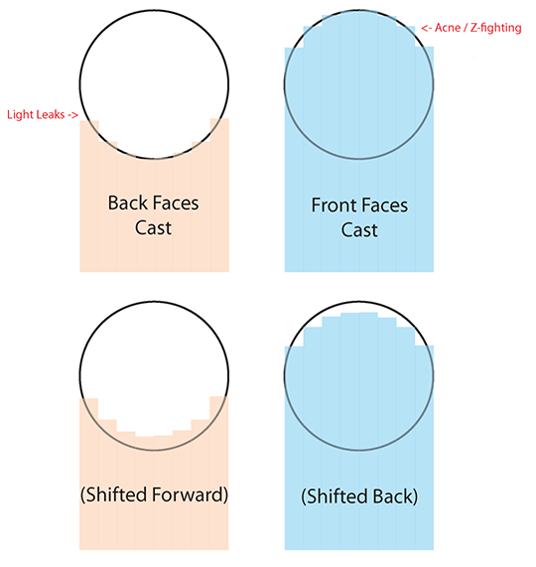
Depth Bias
http://i.imgur.com/8kEZ1En.png
Notes:
light leaking - biased the shadow too far away, so shadow doesn’t appear under some areas

Slide 17
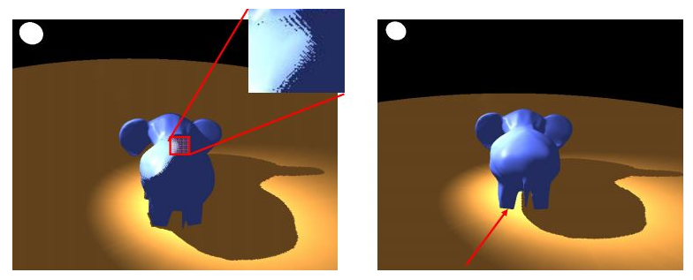
Depth Bias
Too little depth bias causes z-fighting
Too much depth bias causes light leaking
http://developer.amd.com/media/gpu_assets/Isidoro-ShadowMapping.pdf
Notes:
light leaking - biased the shadow too far away, so shadow doesn’t appear under some areas

Slide 18

Depth Bias
Bias should be dependent on triangle slope
Modified from: http://developer.amd.com/media/gpu_assets/Isidoro-ShadowMapping.pdf

Slide 19
Depth Bias
Use screen space derivatives, which are calculated by hardware.
glPolygonOffset automatically calculates bias using screen space derivatives.
Takes a constant parameter and a slope-scaling parameter
Still need to tweak parameters for particular scenes
Use GLSL commands dFdx and dFdy to convert screen space neighbor pixels to light-space slopes
More involved and computationally expensive

Slide 20
Other Improvements
Increase precision of depth buffer.
GL_DEPTH_COMPONENT16
GL_DEPTH_COMPONENT24
GL_DEPTH_COMPONENT32F
Fit near and far plane of light frustum to fit the scene
Increase shadow map resolution if possible
Linearize depth-buffer.
The camera may be looking at part of the scene that is far away from the light, so we want the same amount of detail here as close to the light.
Notes:
Depth values are usually distributed non-linearly because we often do perspective projections. This means there is a lot more detail nearer to the light, and less detail further from the light.

Slide 21
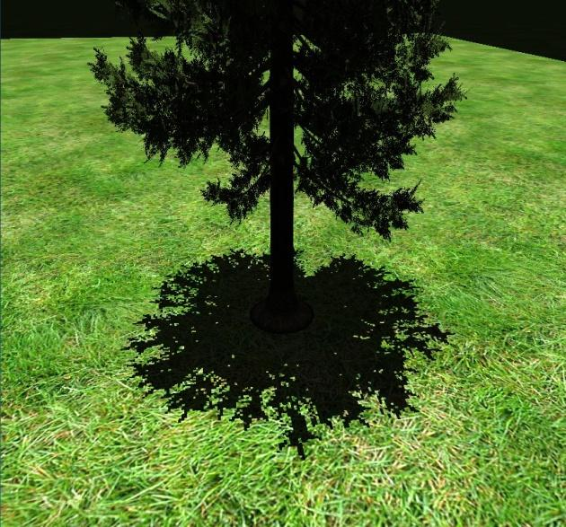
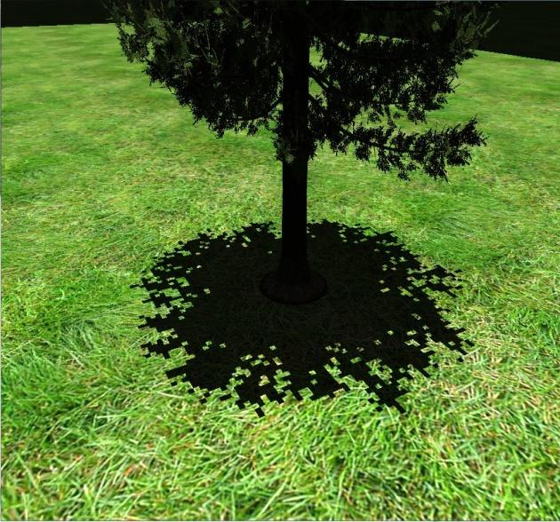
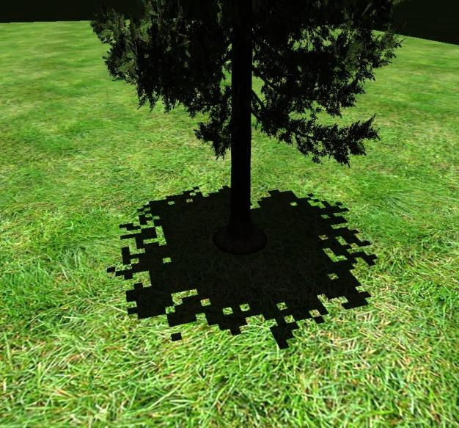
Texture Resolution
Quality dependent on texture resolution
Low res shadow maps produce blocky results
High res shadow maps look better, but take up a lot of memory
What if the scene is really large?
A single texture cannot stretch across the whole world
2048 x 2048
1024 x 1024
512 x 512

Slide 22
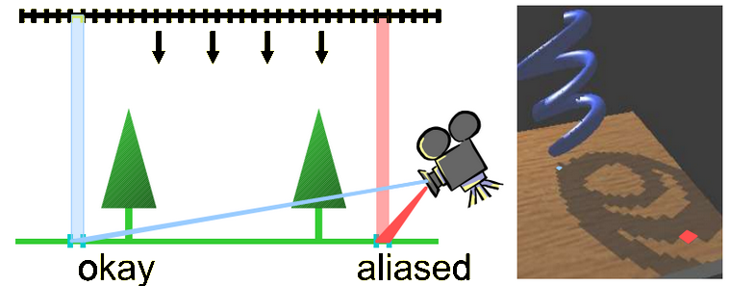
Perspective Aliasing
Size of pixels in view space doesn’t match size of texels in shadow map.
http://www.cg.tuwien.ac.at/~scherzer/files/papers/LispSM_survey.pdf
Notes:
Red square is represented by single texel in shadow map, and it’s not enough detail.
Blue square is also a single texel in shadow map, but since it’s further from the camera there is enough detail.

Slide 23
Advanced Shadow Mapping
Want to fix perspective aliasing
Need more detail near the eye, and less detail away from the eye.
Want to handle texture resolution limits
Maintain constant texture resolution, independent of scene size
Center shadow map around eye
Shadow map should not cover areas that are out of view

Slide 24
Advanced Shadow Mapping
Solutions:
Warping techniques
Perspective Shadow Maps (PSM)
Light Space Perspective Shadow Maps (LiSPSM)
Logarithmic Perspective Shadow Maps (LogPSM)
Frustum partitioning techniques
Cascaded Shadow Maps
aka Z-partitioning, parallel split maps
Sample Distribution Shadow Maps

Slide 25
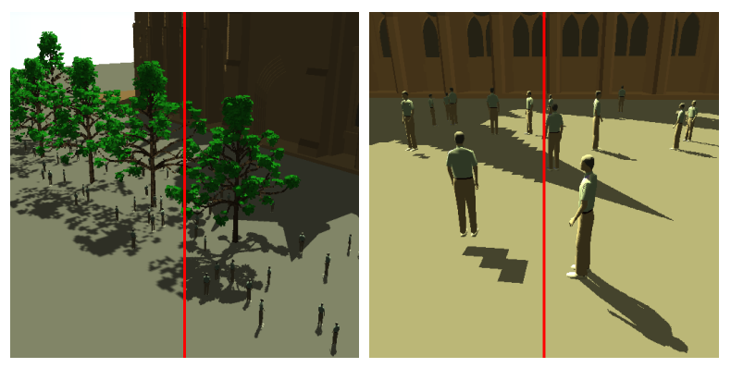
Perspective Shadow Maps
Apply perspective transformation to scene before rendering into shadow map
Simply replace the standard view-projection matrix
Skews shadow map so that there is more density near the eye.
Still uses a single shadow map of the same resolution, but gets more out of it.
http://www-sop.inria.fr/reves/Basilic/2002/SD02/PerspectiveShadowMaps.pdf

Slide 26
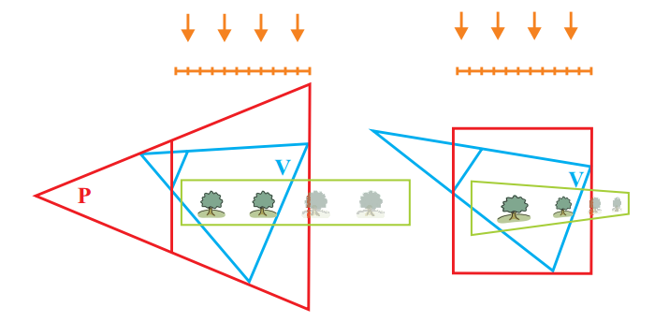
Light Space Perspective Shadow Maps
Fixes limitations of Perspective Shadow Maps
Perspective transformation applied to light view-projection matrix rather than eye view-projection matrix.
Handles shadow casters that are behind the viewer
Lights do not change their type (PSM may convert directional lights to point lights, incorrectly)
Overall more stable and better-distributed error
http://www.cse.chalmers.se/~uffe/SIGGRAPH2012CourseNotes.pdf

Slide 27
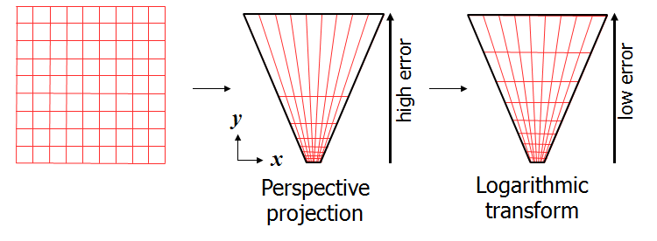
Logarithmic Perspective Shadow Maps
Perspective projection + logarithmic transformation.
Optimal constant error
Requires logarithmic rasterization, which is not supported by current GPU hardware
http://gamma.cs.unc.edu/LOGPSM/

Slide 28
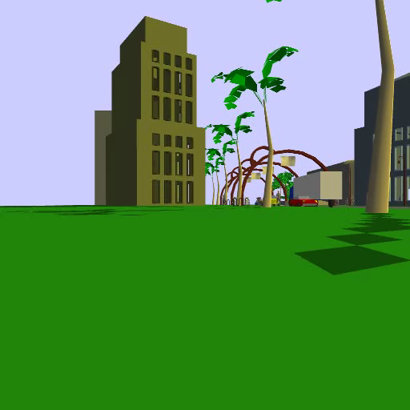
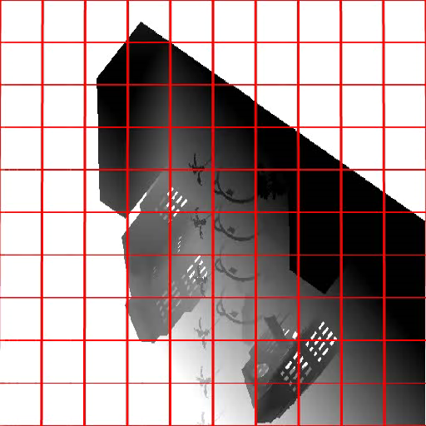
Results
Standard shadow map
http://gamma.cs.unc.edu/LOGPSM/

Slide 29
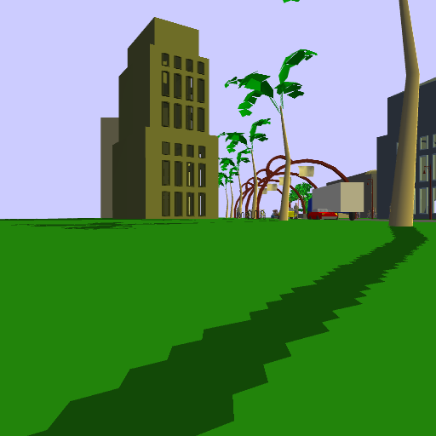
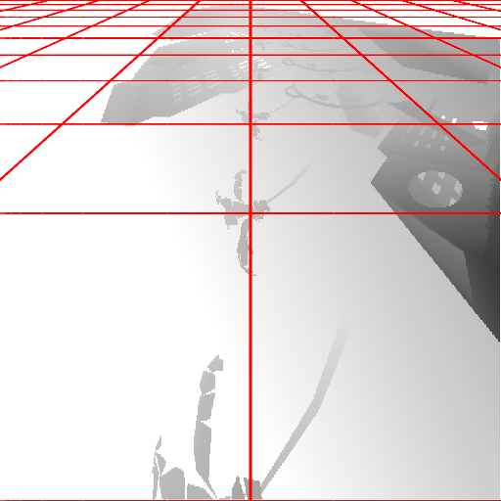
Results
Perspective Warping (LiPSM)
http://gamma.cs.unc.edu/LOGPSM/

Slide 30
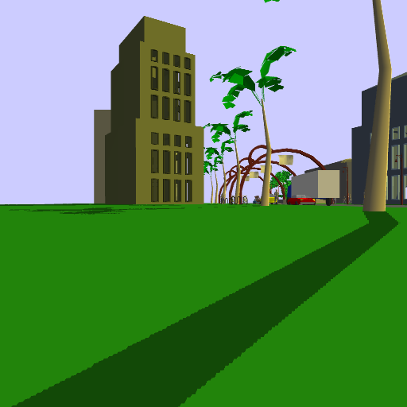
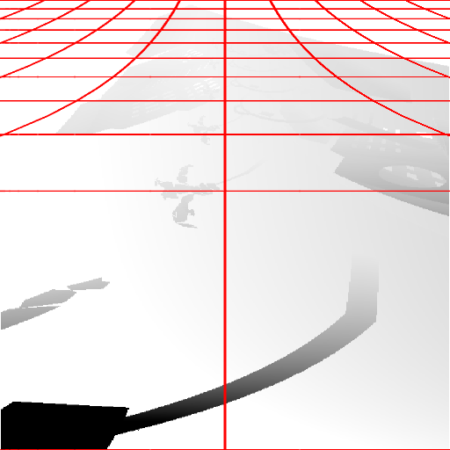
Results
Logarithmic Perspective Warping
http://gamma.cs.unc.edu/LOGPSM/

Slide 31
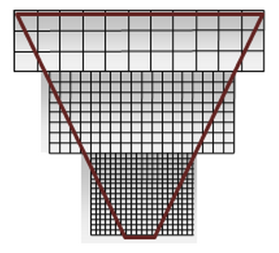
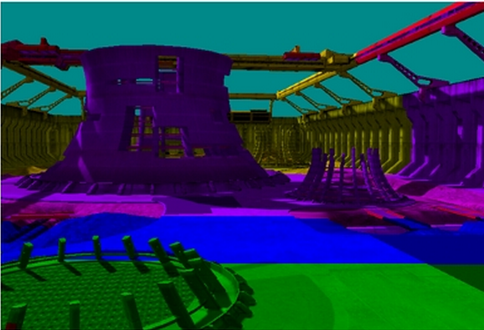
Cascaded Shadow Maps
Partition light frustum into multiple frusta
Higher density near the eye, lower density away from the eye
Each subfrustum gets its own shadow map. They are all the same size.
Fragment shader samples the appropriate shadow map
May use warping methods within each subfrustum
http://msdn.microsoft.com/en-us/library/windows/desktop/ee416307(v=vs.85).aspx

Slide 32
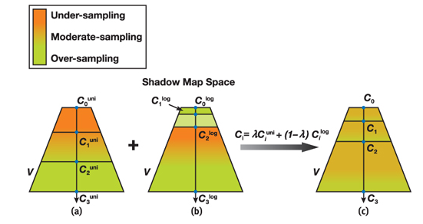
How to choose the partitions?
Chose static partitions based on specific views
Birds eye view requires only a few cascades
Standard walking view requires multiple cascades when the scene extends far.
Annoying to always tweak parameters
Split types
Artist determined
Uniform
Logarithmic
Find midpoint
http://http.developer.nvidia.com/GPUGems3/gpugems3_ch10.html

Slide 33
How to choose the partitions?
Better to have a dynamic approach
Sample Distribution Shadow Maps
Use geometry information and occlusion tests to create tightly bound frusta.
Approximate logarithmic splits
A more complicated approach involves analyzing the z distribution of samples (from the camera’s point of view) in a compute shader.

Slide 34
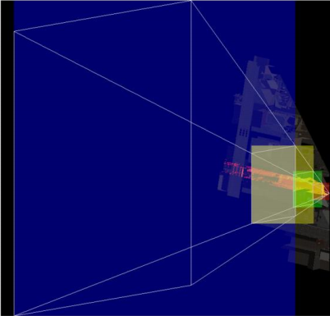
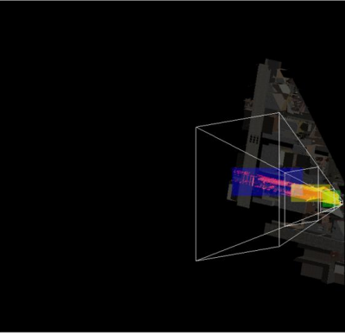
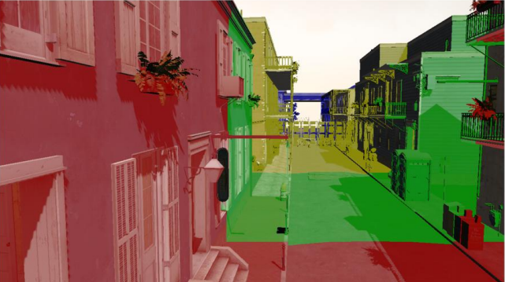
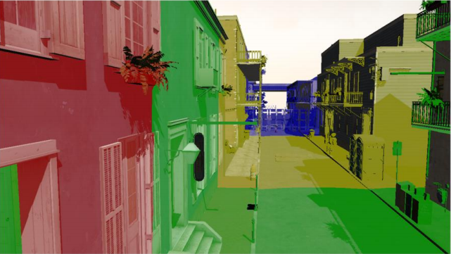
Results
Standard Cascaded Shadow Maps
Sample Distribution Shadow Maps
http://visual-computing.intel-research.net/art/publications/sdsm/sampleDistributionShadowMaps_SIGGRAPH2010_notes.pdf

Slide 35
Smoothing Hard Shadows
Linear Filtering
Percentage Closer Filtering
Variance Shadow Maps

Slide 36
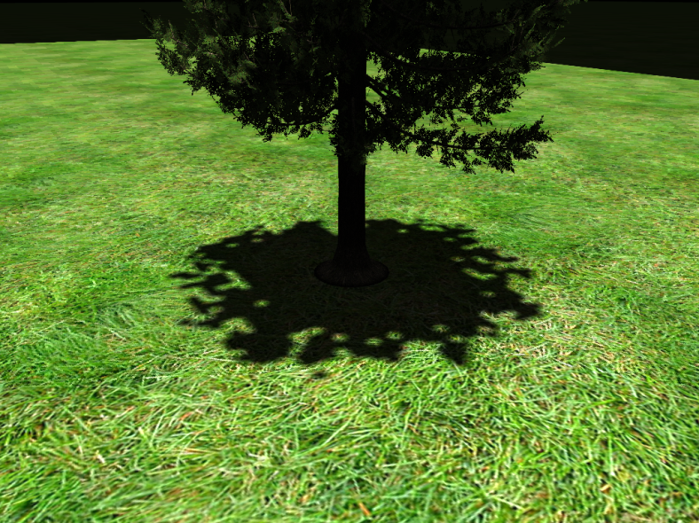
Linear Filtering
Enable linear filtering on shadow map texture
Interpolates depth between 2x2 region of pixels instead of just choosing the depth of the closest pixel
Really, really simple. But not exactly correct.
512x512 with GL_NEAREST
512x512 with GL_LINEAR

Slide 37
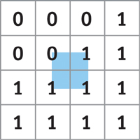
Percentage Closer Filtering
Simulate soft shadows by looking at neighboring shadow texels.
Take 4 nearest samples in shadow map
Use GLSL command textureGather
Compare the surface’s depth with each of these samples.
Supply surface depth to textureGather call
Bilinearly interpolate the results
Different than linear filtering, which interpolates the depth values and not the results of the comparisons.
To get a larger penumbra, sample 16 nearest texels with 4 textureGather calls.
http://http.developer.nvidia.com/GPUGems/gpugems_ch11.html

Slide 38
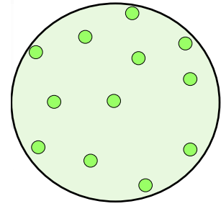
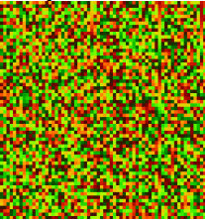
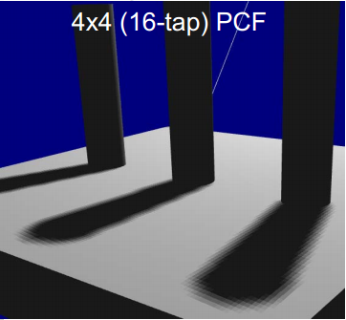
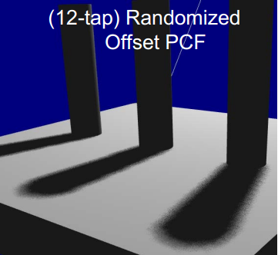
Percentage Closer Filtering
Sample random neighbors to get a less patterned look
Use a non-uniform disk. Rotate the disk using random rotations stored in a texture.
http://developer.amd.com/media/gpu_assets/Isidoro-ShadowMapping.pdf

Slide 39
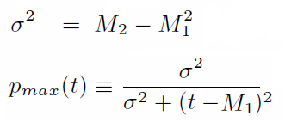
Variance Shadow Maps
Store depth in one map, and depth² in another
Filter these maps to your liking
Mip-map
Gaussian blur
Summed area tables
Determine fragment’s shadow strength through a probability function
Where M1 = shadow map sample
M2 = depth² shadow map sample
t = fragment depth
σ² = variance
pmax = max % of samples in light
http://graphics.stanford.edu/~mdfisher/Shadows.html

Slide 40
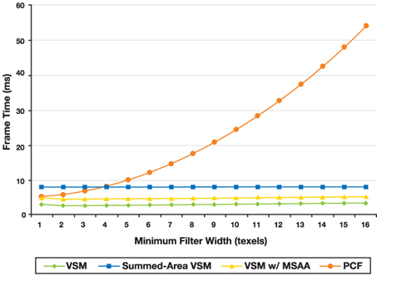
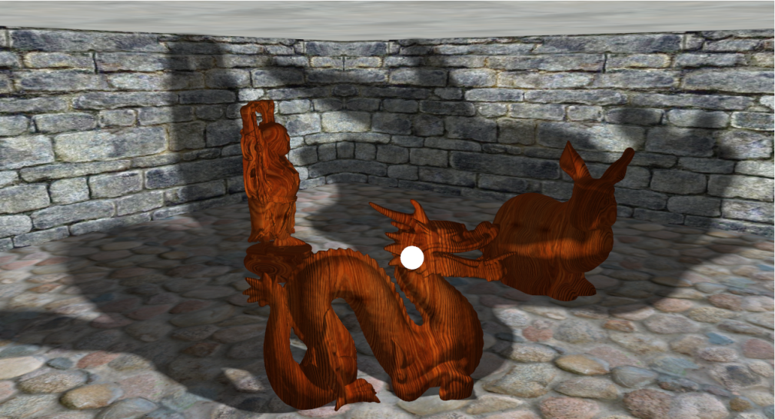
Variance Shadow Maps
Advantages:
Able to capture large penumbra at a much smaller cost than PCF
Does a great job of blurring low res shadow maps
21 x 21 blur filter kernel with Six 512x512 shadow maps
Running at 141 fps
http://graphics.stanford.edu/~mdfisher/Shadows.html
http://http.developer.nvidia.com/GPUGems3/gpugems3_ch08.html

Slide 41
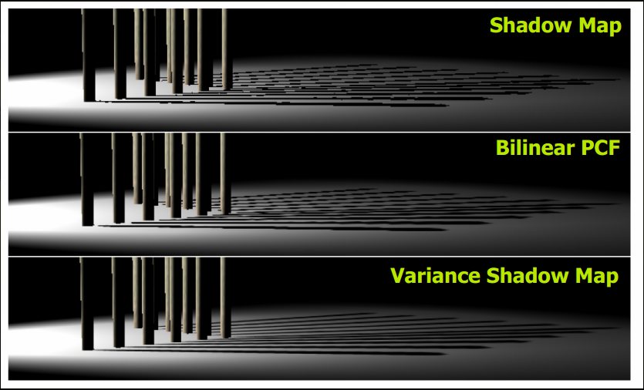
Variance Shadow Maps
http://http.download.nvidia.com/developer/presentations/2006/gdc/2006-GDC-Variance-Shadow-Maps.pdf

Slide 42
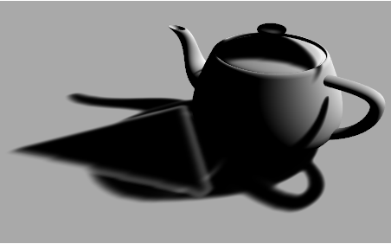
Variance Shadow Maps
Main problem: light bleeding
Happens when more than two occluders that are far apart shadow the same region.
At the lit edges, the probability function uses the depth of the triangle to estimate the shadow strength.
The depth map can only store one sample per pixel, so there is no understanding of a second, closer occluder (the teapot)
Somehow we need to know the depth distribution …
http://pixelstoomany.wordpress.com/category/shadows/light-bleeding/

Slide 43
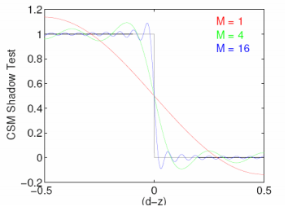
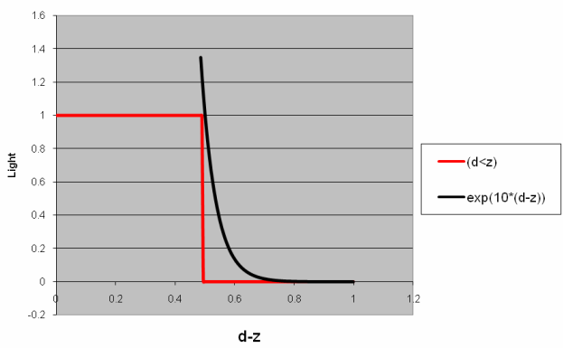
Variance Shadow Maps
Light Bleeding solutions
Add variance threshold so that you never get very light areas
But makes the shadow falloff too strong
Represent discrete depth steps with smooth functions
Convolution shadow maps
Approximate depth steps with 1D Fourier expansion
Exponential shadow maps
Approximate step function with exponential function
http://developer.download.nvidia.com/presentations/2008/GDC/GDC08_SoftShadowMapping.pdf

Slide 44
Which techniques to use?
What shadow technique family should I use?
Shadow Volumes or Shadow Mapping?
Shadow Mapping
Which technique should I use to combat perspective aliasing and shadow map resolution issues?
Warped perspective shadow maps or Cascaded Shadow Maps?
Cascaded Shadow Maps
Which soft shadow technique should I use?
Percentage Closer Filtering for hard shadows with soft edges
Variance Shadow Maps for very soft shadows
Which technique should I use to fix light bleeding?
Exponential Shadow Maps
What more can I do to make my shadows better?
Use ambient occlusion to approximate global illumination
Screen space effects like depth of field and motion blur can help smooth shadow artifacts.

Slide 45
WebGL demo
http://codeflow.org/entries/2013/feb/15/soft-shadow-mapping/

Slide 46
Resources
Every image credit leads to a valuable resource on that topic.
I referenced the following books:
Real-Time Rendering, Third Edition by Akenine-Moller, Haines, and Hoffman
Real-Time Shadows by Eisemann, Schwarz, Assarsson, and Wimmer

